Slide 1


Slide 2

Digital Marketing
Assignment Report
ASSIGNMENT FOLIO
Assignment Folio of
Digital Marketing
Submitted to
Dezyne École College
Toward Digital Marketing
By
BCA
3rd Semester
Meenakshi Mali
Dezyne École College
106/10, Civil Lines, Ajmer
www.dezyneecole.com
2026-2028

Slide 3
Digital Marketing
Case Study
ASSIGNMENT FOLIO
We take this opportunity to express our sincere gratitude to Dezyne École College for providing us with the knowledge, resources, and guidance essential to the successful completion of this project.
Our deepest thanks to our respected Principal, Dr. Vinita Mathur, for her visionary leadership and continuous encouragement. Her commitment to academic excellence and student growth has been a constant source of motivation and pride.
We are equally thankful to all our faculty members for their consistent support, expert advice, and valuable insights that shaped our learning and helped us achieve this milestone.
Lastly, we extend heartfelt thanks to everyone who directly or indirectly contributed to the success of this project.
We are proud to be part of Dezyne École College, an institution that truly nurtures professionalism, innovation, and purpose.
With sincere appreciation,
Meenakshi Mali
Department of BCA
Dezyne École College, Ajmer

Slide 4
Digital Marketing
Case Study
ASSIGNMENT FOLIO
Objective:
Increase Website Traffic, Generate Quality Leads, Improve Brand Visibility, Boost Course Enrolments & Maximise ROI
1. Search Campaign Strategy
Targeted high-intent keywords related to computer courses.
2. Structure Ad Groups
Separate ad groups for each course to improve relevance and Quality Score.
3. Optimized Wix Landing Page
Mobile-friendly design with strong call-to-action buttons.
4. Conversion Tracking Setup
Measure form submissions and call clicks for performance analysis.
5. Smart Bidding Strategy
Used “Maximize Conversions” to optimize ad spend automatically.

Slide 5
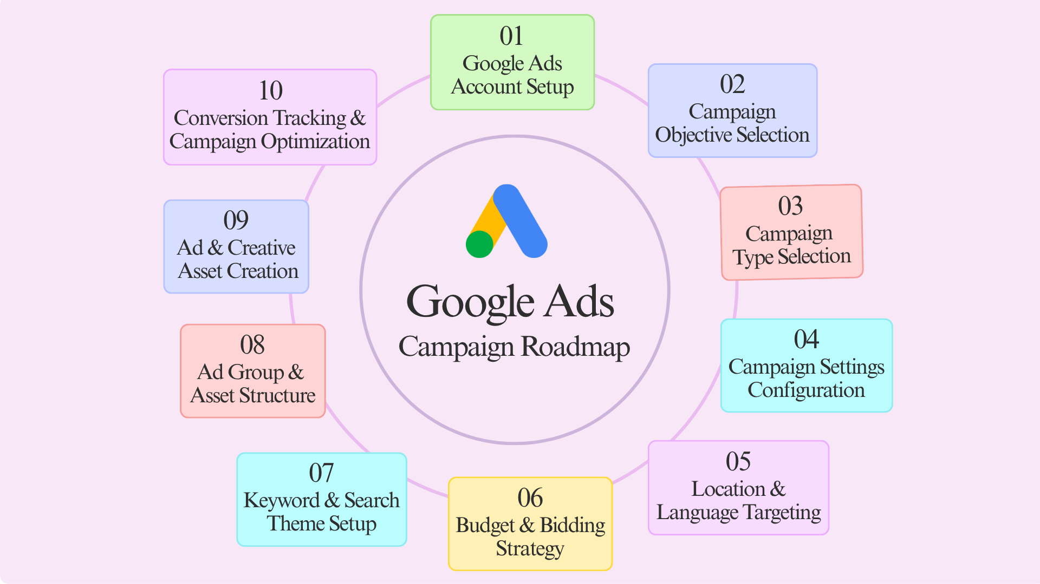

Slide 6

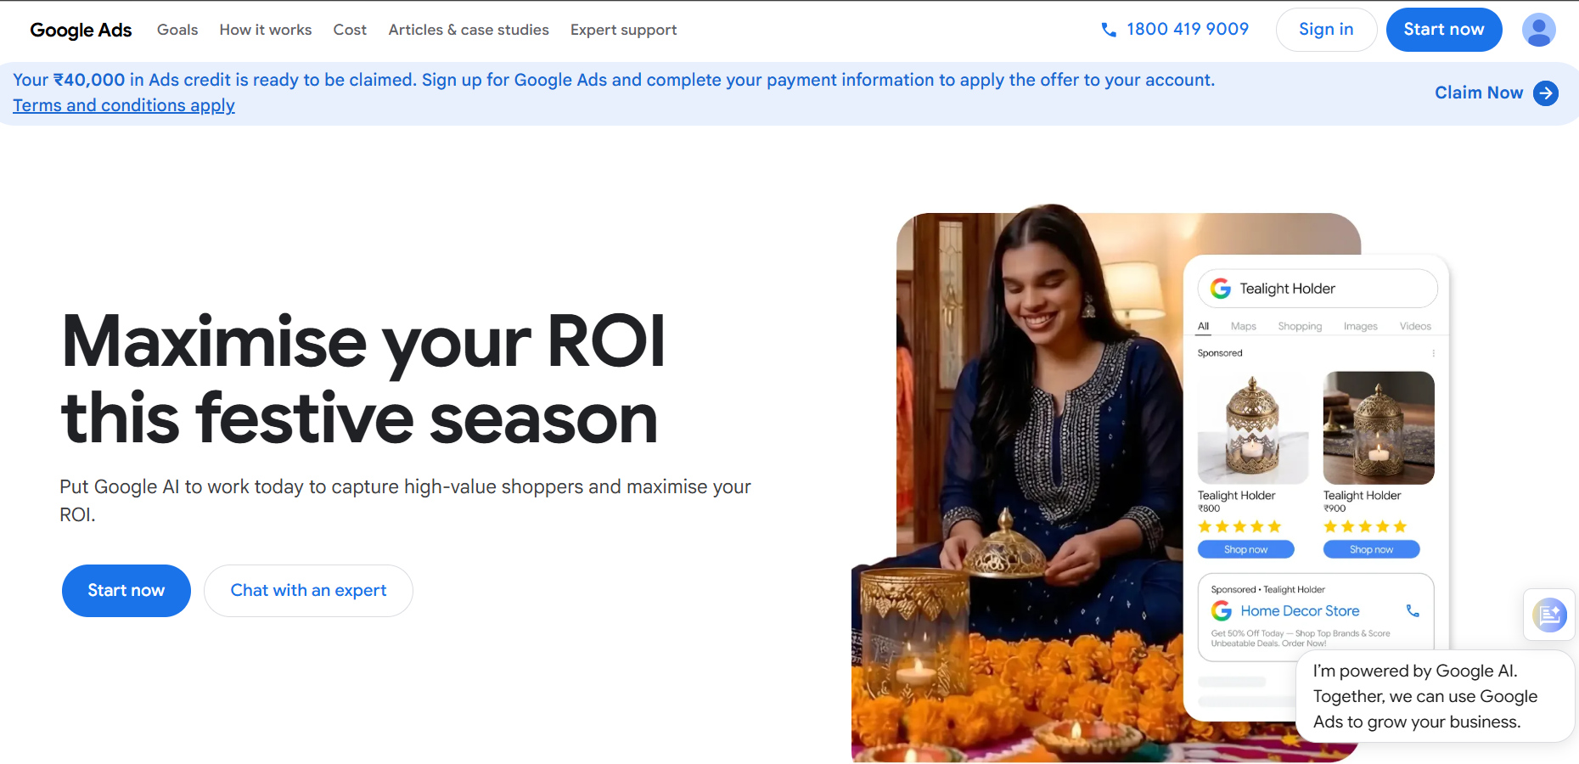
Google Ads - Overview

Slide 7
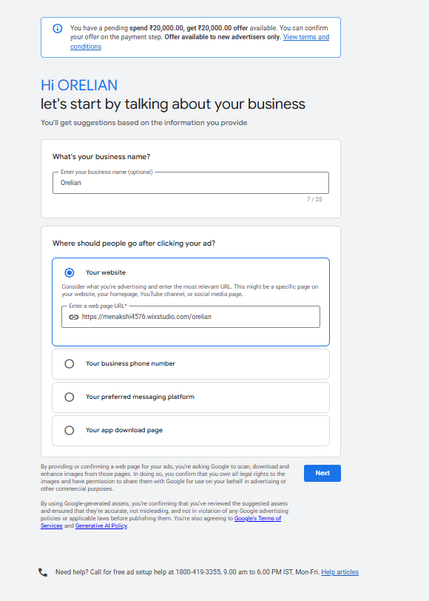
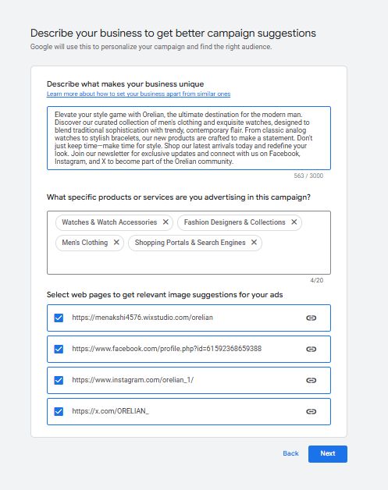
Google Ads Account Setup

Slide 8
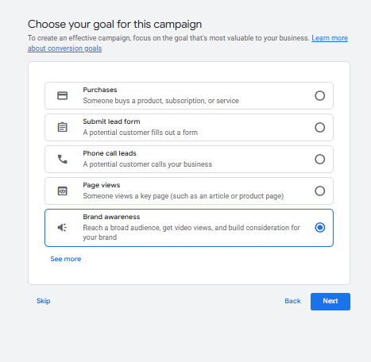
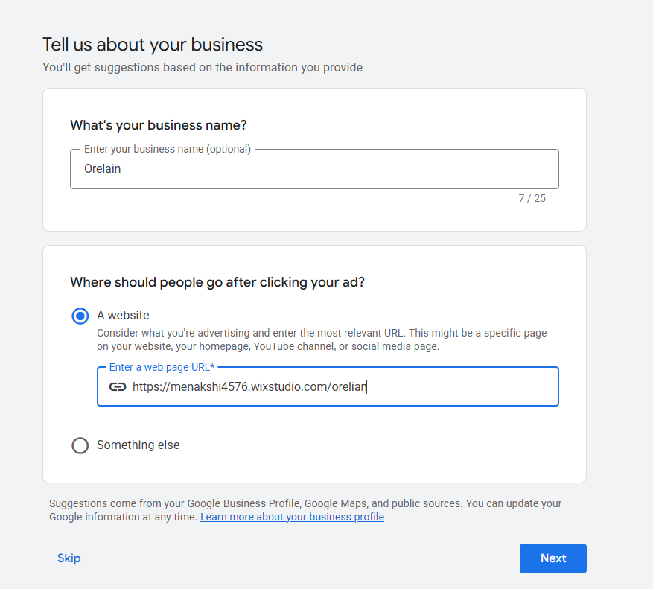
Google Ads Account Setup

Slide 9
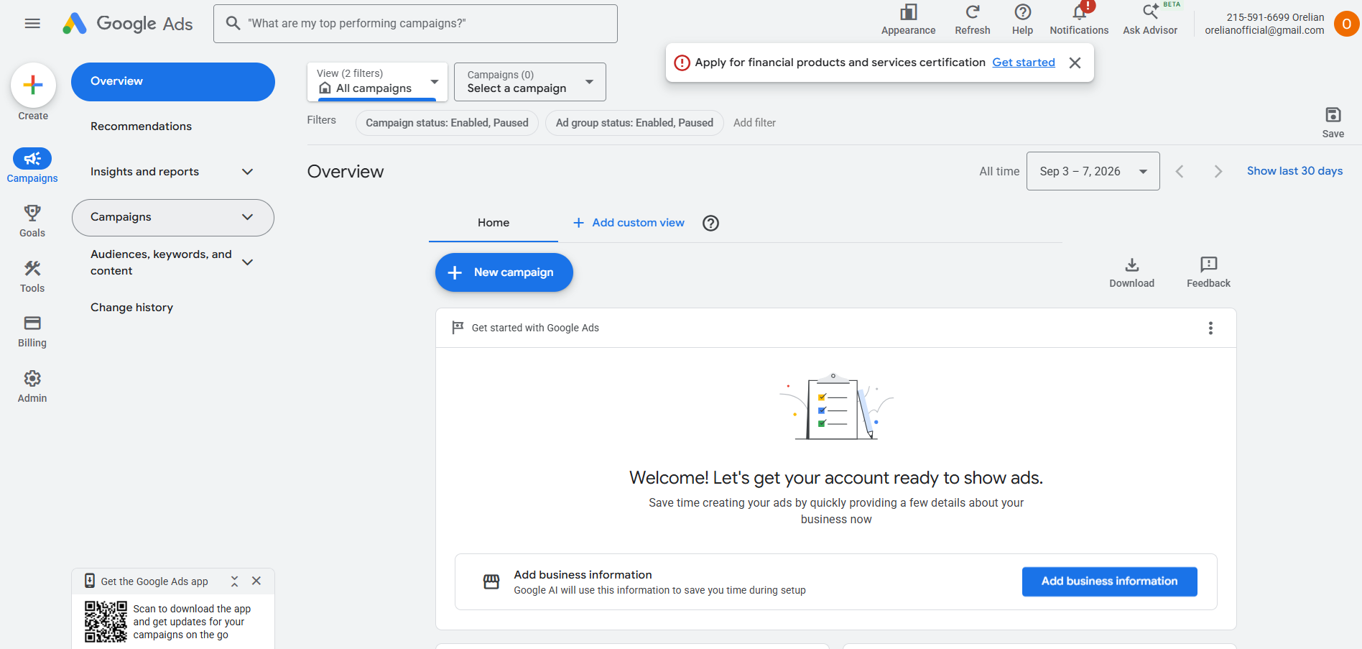
Google Ads Dashboard

Slide 10
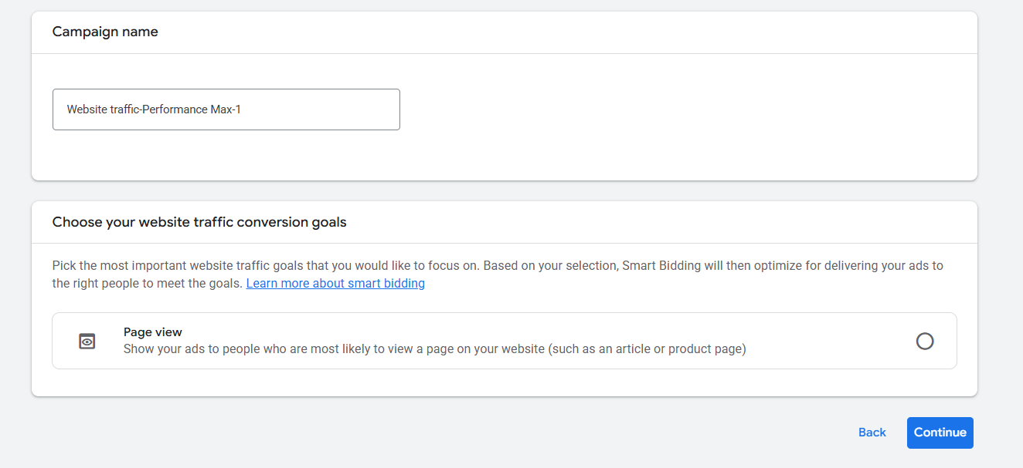
Campaign Setup

Slide 11
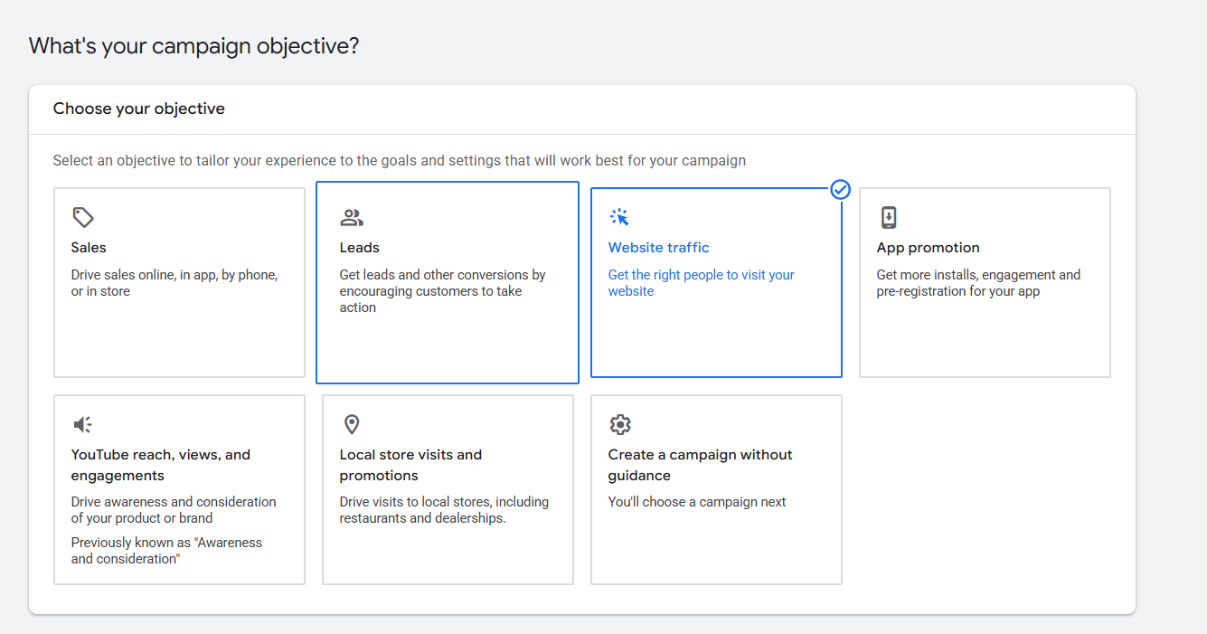
Campaign Objective

Slide 12
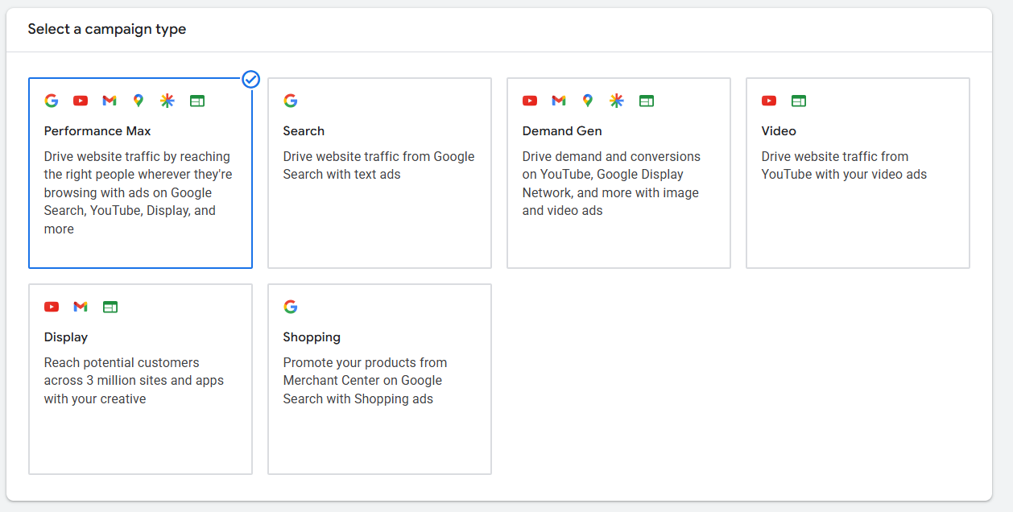
Campaign Types

Slide 13
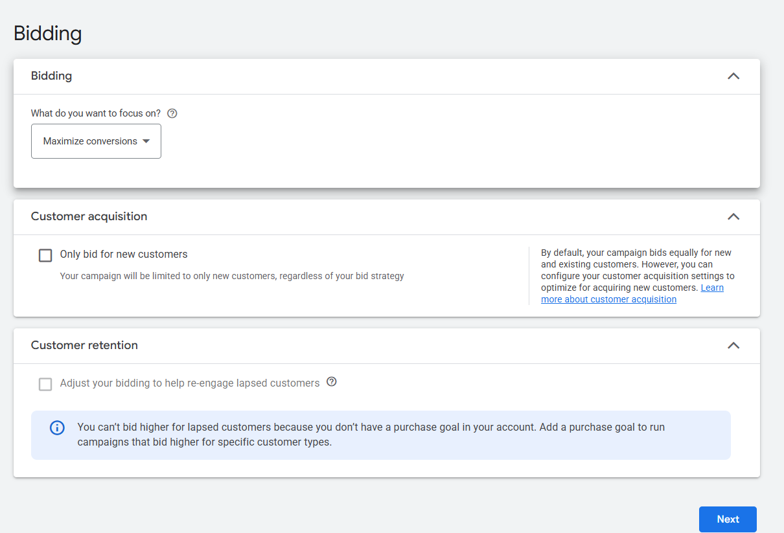
Bidding

Slide 14
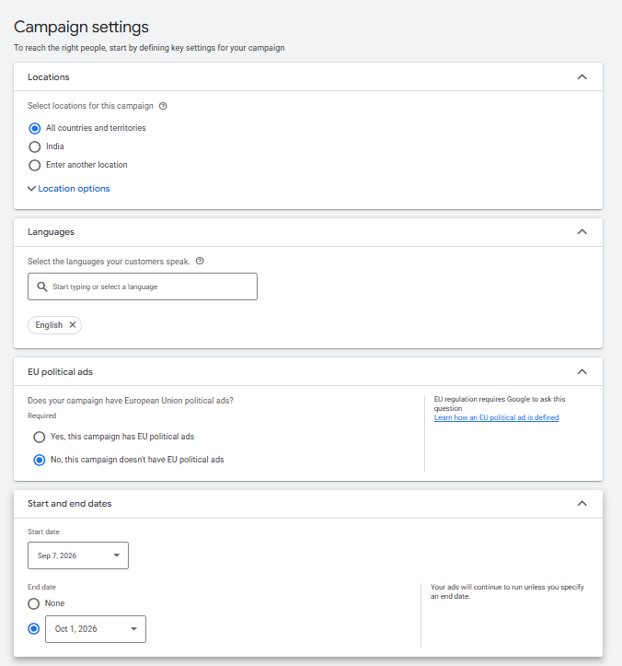
Campaign Setting: Location and Language

Slide 15
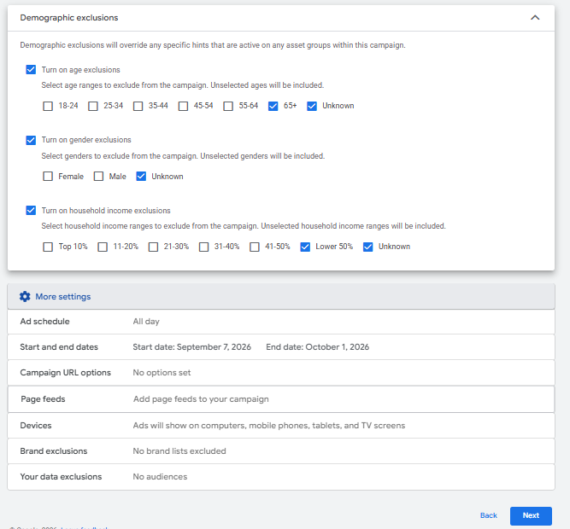
Campaign Setting

Slide 16
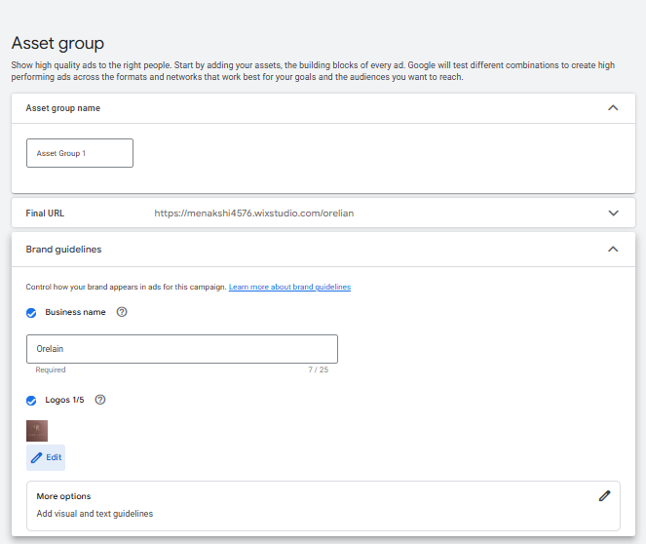
Campaign Setting: Asset Group

Slide 17
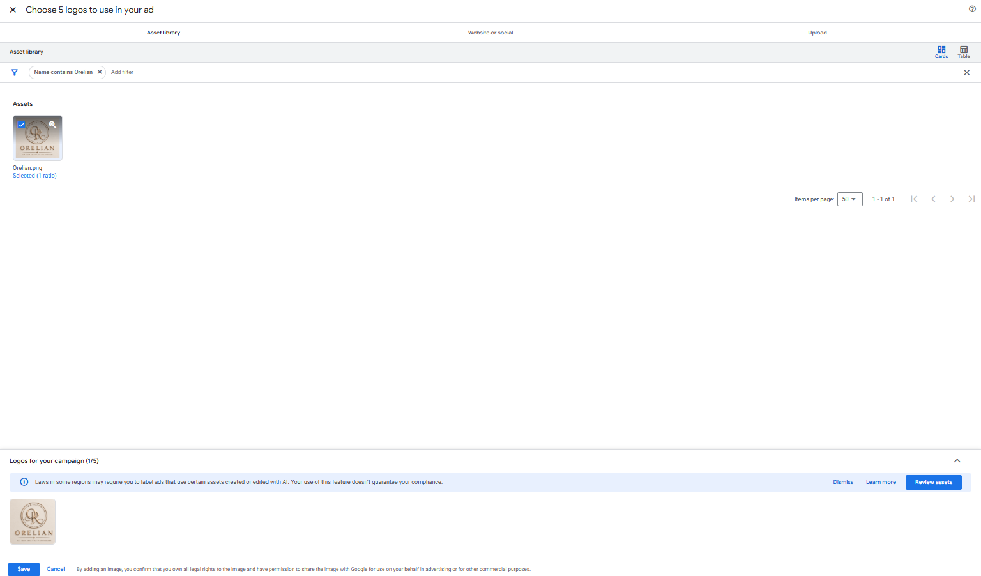
Campaign Setting: Asset Group

Slide 18
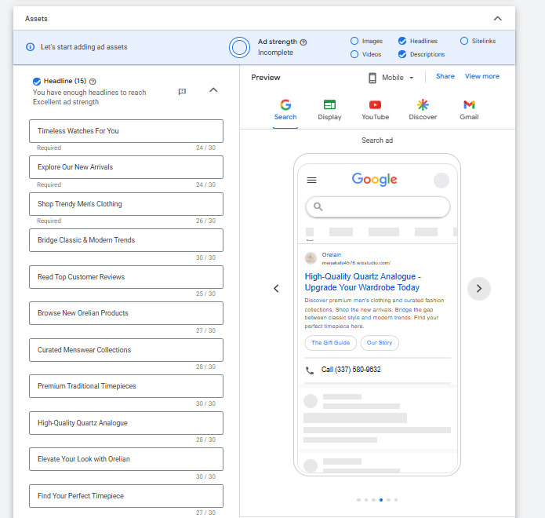
Campaign Setting: Asset Group

Slide 19
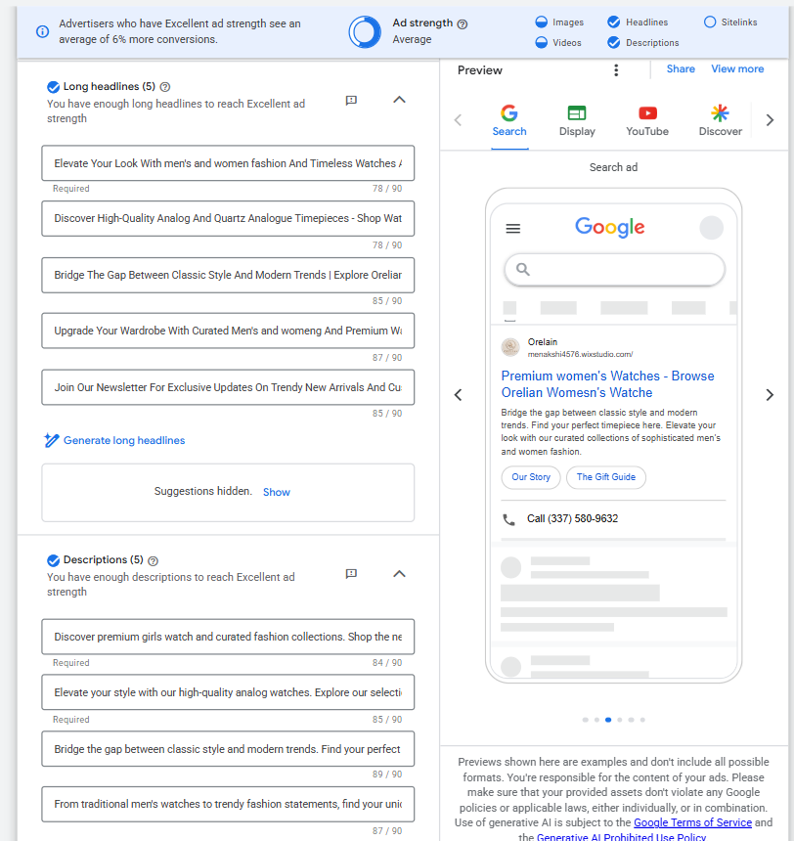
Campaign Setting: Asset Group

Slide 20
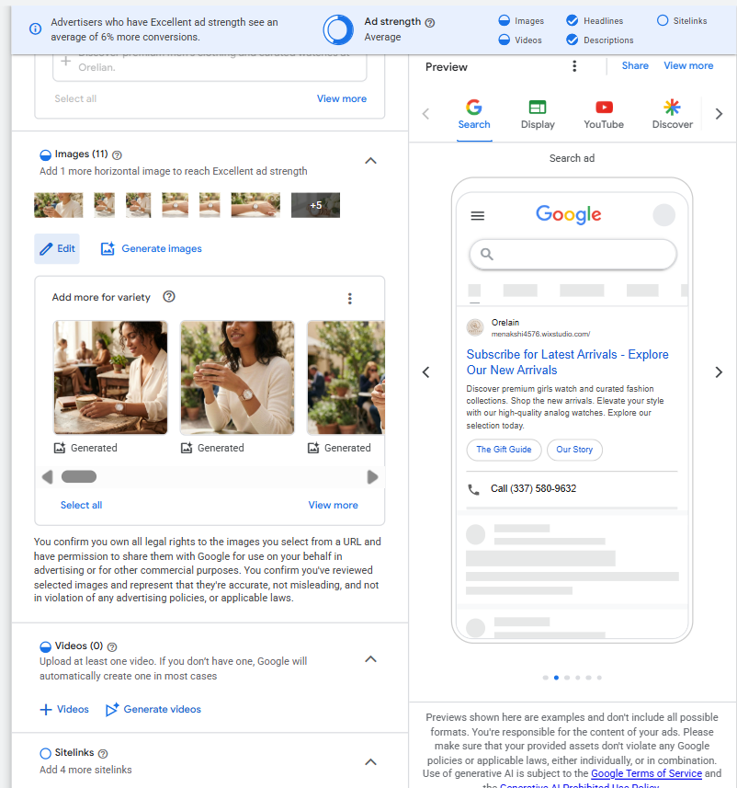
Campaign Setting: Asset Group

Slide 21
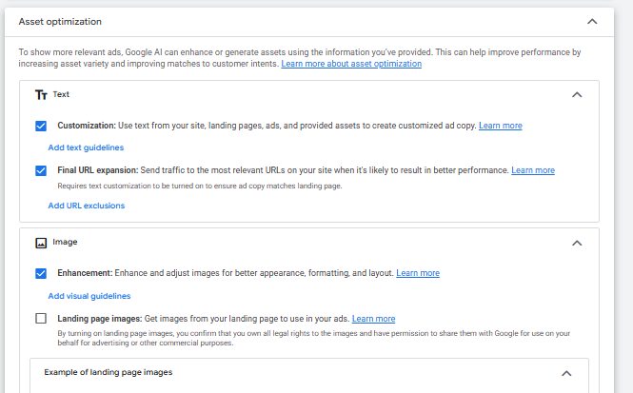
Campaign Setting: Signals

Slide 22
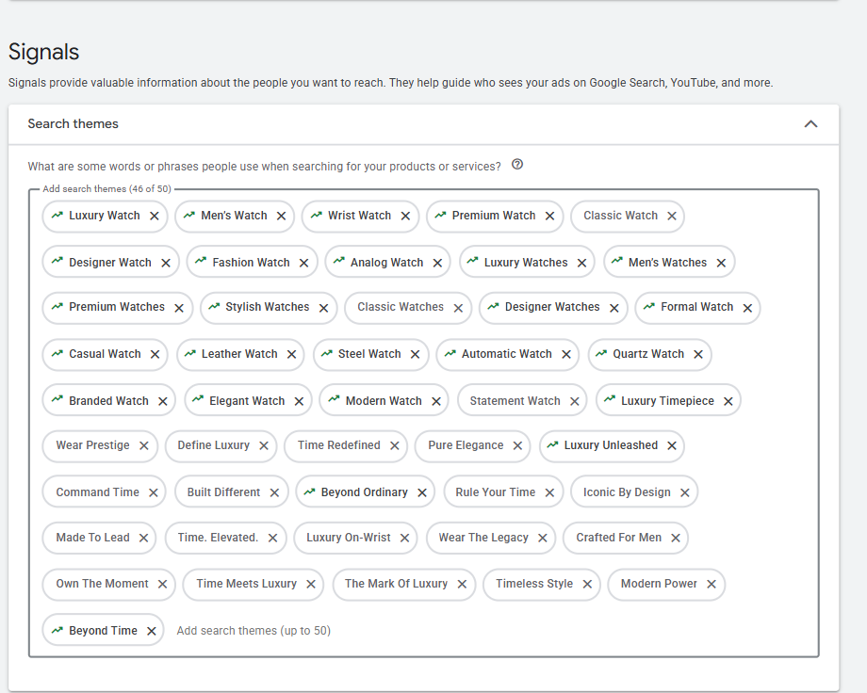
Campaign Setting: Signals

Slide 23
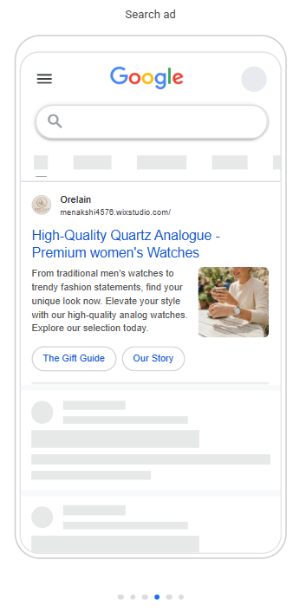
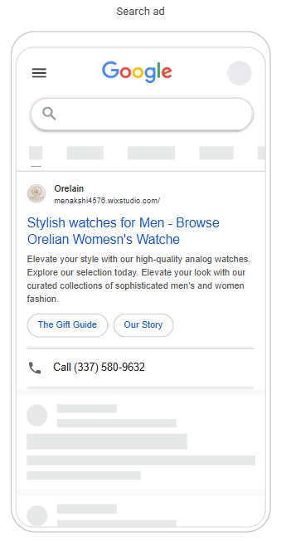
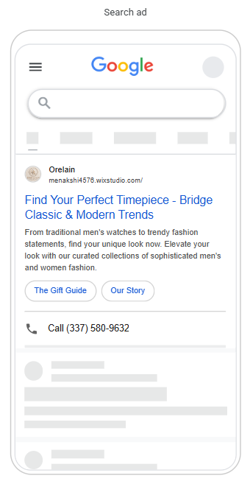
Ads Preview

Slide 24
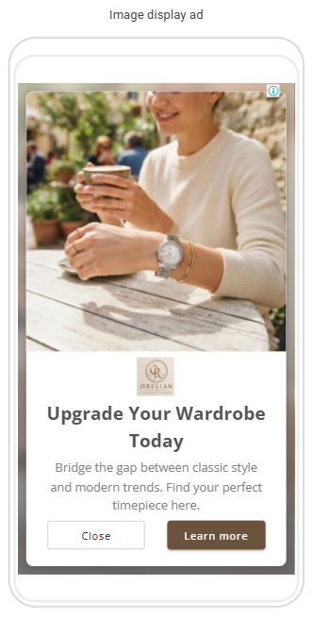
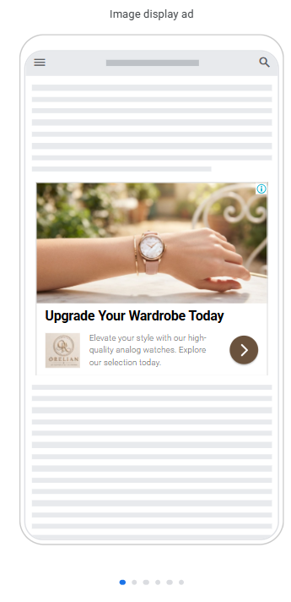
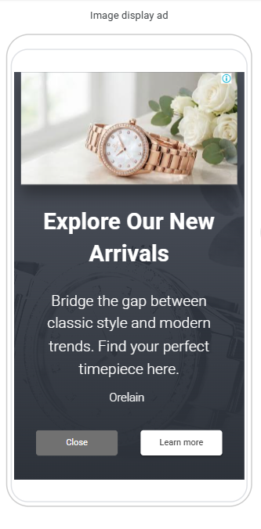
Ads Preview

Slide 25
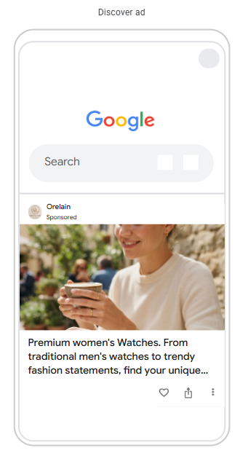
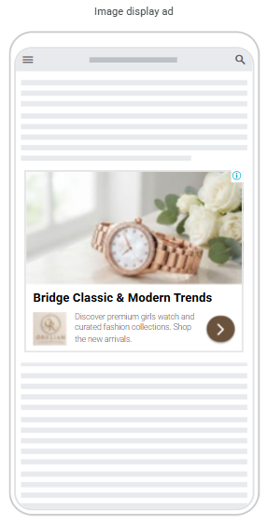
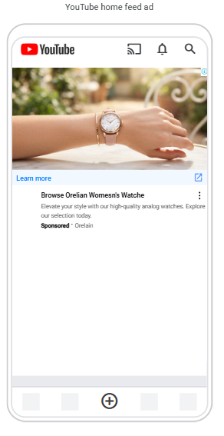
Ads Preview

Slide 26
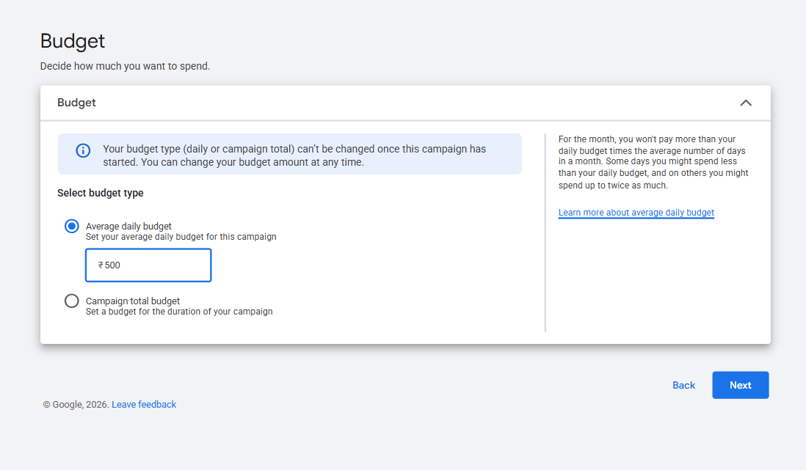
Google Ads Budget

Slide 27
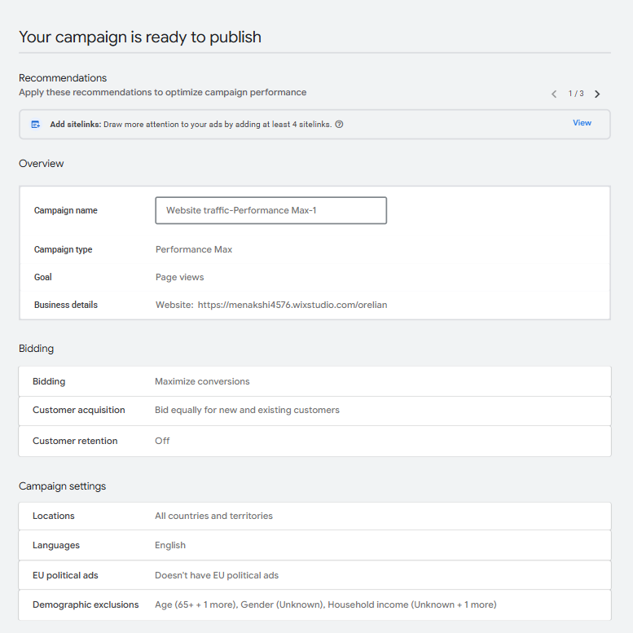
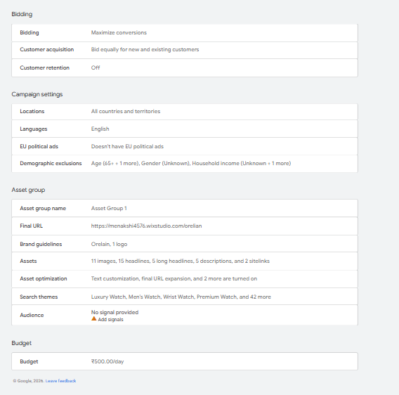
Google Ads Campaign Review

Slide 28
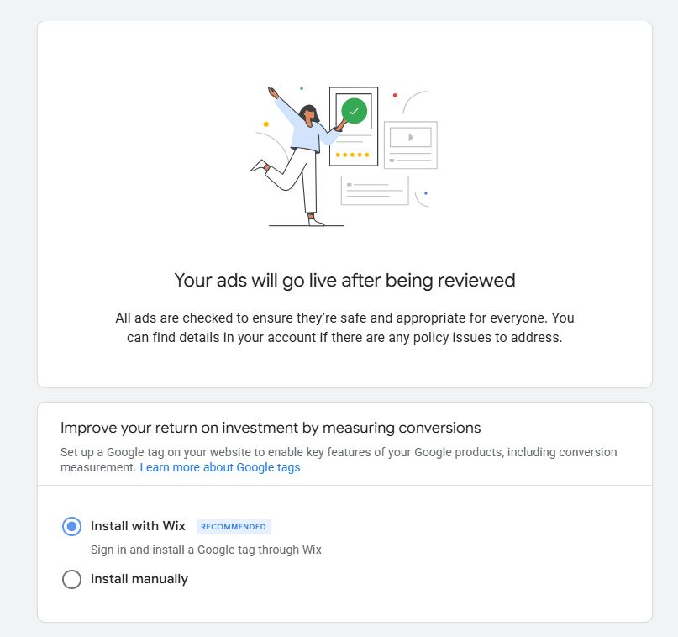
Google Ads Campaign Review

Slide 29
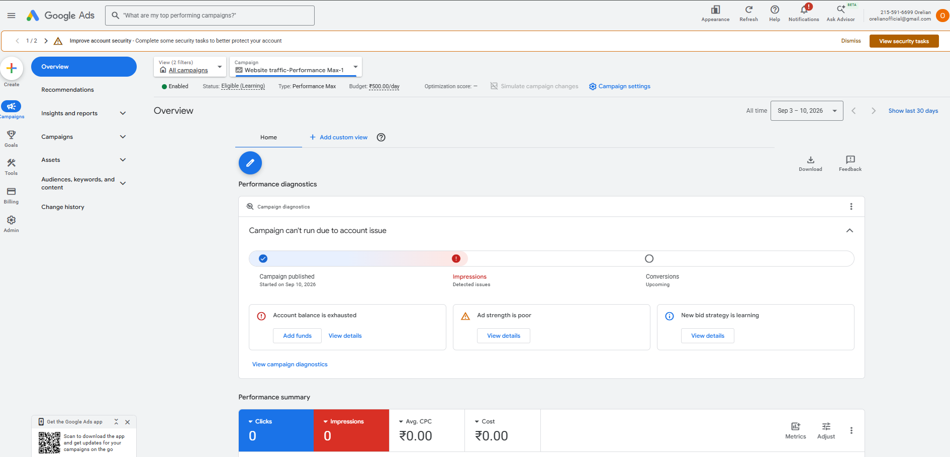
Campaign Dashboard

Slide 30


